Slide 1
Lab 2 Variable and Arithmetic operation
CSC-113
Engr. Ramsha Mashood
COMPUTER PROGRAMMING

Slide 2
Introduction
There are various ways to read input from the keyboard:
Console.ReadLine();
Reads the next line of characters from the standard input stream.
Console.Read();
Reads the next character from the standard input stream.
Console.ReadKey();
Obtains the next character or function key pressed by the user.
It has the ability to share or distribute its workload among other processors and input/output terminals.

Slide 3
example 1 (Solution 2)
static void Main(string[] args) {
Console.WriteLine("Please Enter Your Good Name");
//Variable for storing string value
//Accepting and holding values in name variable
string name = Console.ReadLine();
//Displaying Output
Console.WriteLine("Welcome ” + name +” in your first csharp program");
//Holding console screen
Console.ReadLine();
}

Slide 4
Primitives Data Types
Type | Represents | Range | Default Value
Bool | Boolean value | True or False | False
char | 16-bits Unicode character | U +0000 to U +ffff | '\0'
double | 64-bit double-precision floating point type | (+/-)5.0 x 10⁻³²⁴ to (+/-)1.7 x 10³⁰⁸ | 0.0D
float | 32-bit single-precision floating point type | -3.4 x 10³⁸ to + 3.4 x 10³⁸ | 0.0F
int | 32-bit signed integer type | -2,147,483,648 to 2,147,483,647 | 0
long | 64-bit signed integer type | -9,223,372,036,854,775,808 to 9,223,372,036,854,775,807 | 0L
string | Textual data (A sequence of characters)
short | 16-bit signed integer type | -32,768 to 32,767 | 0

Slide 5
CONT…
Datatypes:
int and char
To declare integer variables:
int num1 = 124;
To declare char variables:
char ch= ‘a’;

Slide 6
Operators
An operator is a symbol that tells the compiler to perform specific mathematical or logical manipulations. C# has rich set of built-in operators and some type of operators are listed below:
Arithmetic Operators
Relational Operators
Logical Operators
Assignment Operators

Slide 7
Arithmetic Operators
Assume variable A holds 10 and variable B holds 20 then:
Operator | Description | Example
+ | Adds two operands | A + B = 30
- | Subtracts second operand from the first | A - B = -10
* | Multiplies both operands | A * B = 200
/ | Divides numerator by de-numerator | B / A = 2
% | Modulus Operator and remainder of after an integer division | B % A = 0

Slide 8
Type Conversion
Type conversion is converting one type of data to another type. It is also known as Type Casting. In C#, type casting has two forms:
Implicit type conversion - These conversions are performed by C# in a type-safe manner. For example, are conversions from smaller to larger integral types and conversions from derived classes to base classes.
Explicit type conversion - These conversions are done explicitly by users using the pre-defined functions. Explicit conversions require a cast operator.

Slide 9
Implicit Type Casting
int num1 =20000;
int num2 =50000;
long total;
// In this the int values are implicitly converted to long data type. You need not to tell compiler to do the conversion, it automatically does.
total = num1 + num2;
Console.WriteLine("Total is : " + total);

Slide 10
C# Type Conversion Methods
S. No. | Methods & Description
1 | ToBoolean: Converts a type to a Boolean value, where possible.
2 | ToChar: Converts a type to a single Unicode character, where possible.
3 | ToDateTime: Converts a type (integer or string type) to date-time structures.
4 | ToDecimal: Converts a floating point or integer type to a decimal type.
5 | ToDouble: Converts a type to a double type.
6 | ToInt16: Converts a type to a 16-bit integer.
7 | ToInt32: Converts a type to a 32-bit integer.
8 | ToInt64:Converts a type to a 64-bit integer.

Slide 11
Cont.
S. No. | Methods & Descriptions
9 | ToSingle: Converts a type to a small floating point number.
10 | ToString: Converts a type to a string.
11 | ToType: Converts a type to a specified type.
12 | ToUInt16: Converts a type to an unsigned int type.
13 | ToUInt32: Converts a type to an unsigned long type.
14 | ToUInt64:Converts a type to an unsigned big integer.

Slide 12
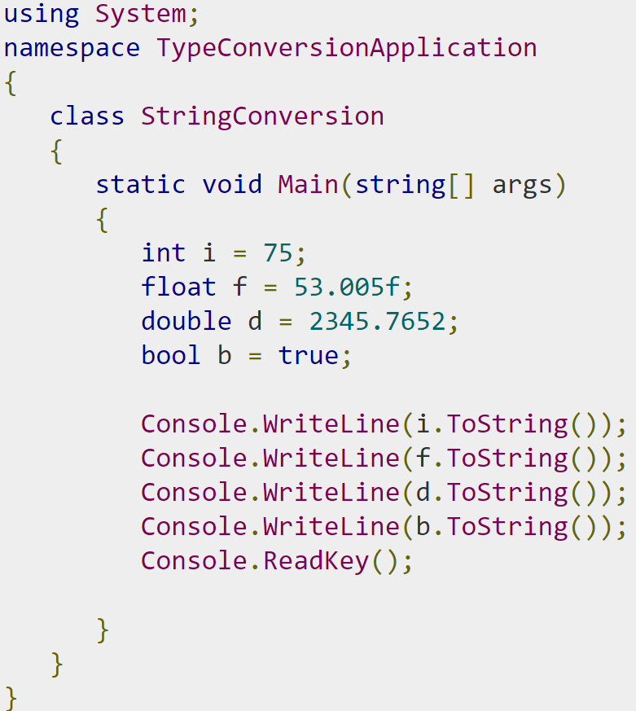
Example

Slide 13
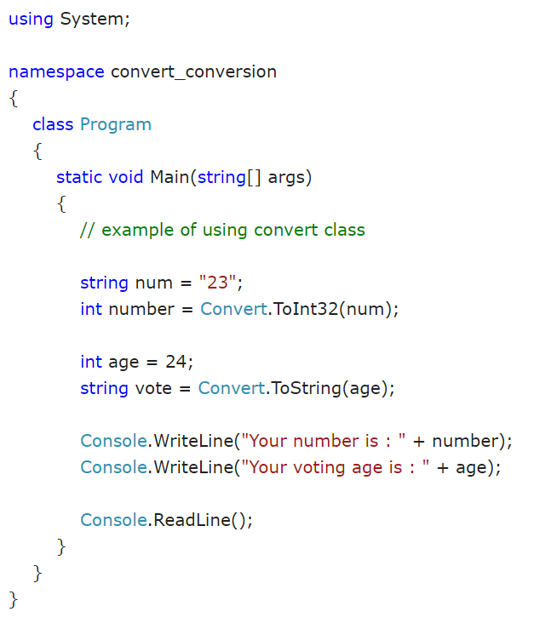
example

Slide 14
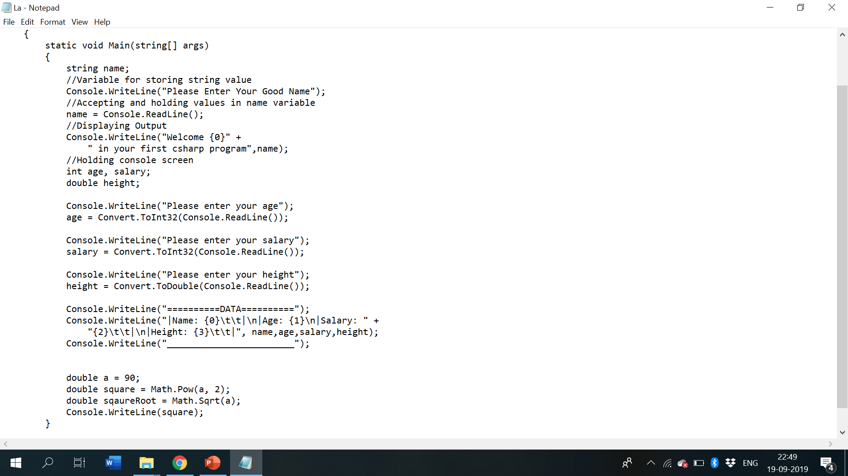
Lab example code

Slide 15
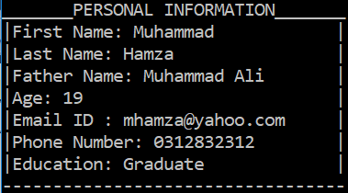
Lab Tasks
Write a program to display your personal information. (Name, age, address, father’s name, college name, NIC, phone number etc. ) and display your marks sheet. ((Use Escape Sequences to create a formatted Output according to the given image).

Slide 16
Lab Tasks
Write a program to display your inter/ matric marks sheet
Write a C# program that displays the results of the expressions:
3.0*5.0
7.1*8.3-2.2
3.2/ (6.1*5)
15/4
15%4
5*3-(6*4).

Slide 17
Lab Tasks Use Datatype: int and string
4. Calculate the temperature in Celsius using integer values.
C = 5/9 * (F – 32)

Slide 18
Lab Tasks (Cont.…)
6. Calculate the area of Circle.
7. Display the result of the expression: ((( a + b) * (c * e * d)) – e)/f
8. Write a program and print the output of first equation of the motion. For values take input from user. (vf=vi+at)
9. Write a program to take personal information from user and display it.

Slide 19
Thanks You

